Slide 1
MUIZENBERG/ ST JAMES/ KALK BAY HERITAGE PROTECTION OVERLAY ZONE (HPOZ) Roles and Responsibilities
Environmental Management Department
Heritage Resources Section
Philip Smith

Slide 2
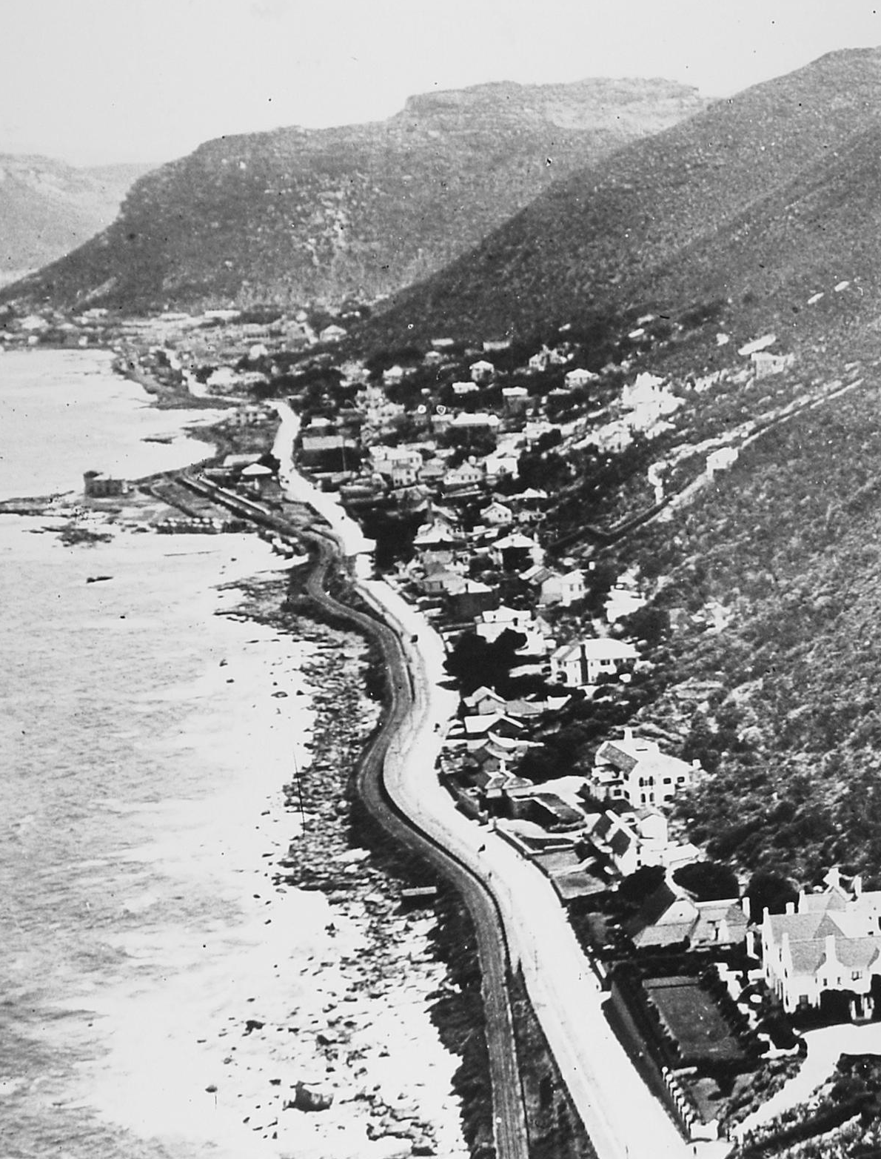
Contents
Introduction and where we fit in (HWC vs City)
Heritage Protections – NHRA vs HPOZ
Extent of HPOZ
HPOZ triggers and exemptions
Available Resources
Roles and Responsibilities
Application process

Slide 3
Introduction
National Heritage Authority
South African Heritage Resources Agency – SAHRA
Provincial Heritage Authority
Heritage Western Cape - HWC
Local Heritage Authority
City of Cape Town - CoCT
CITY OF CAPE TOWN
Spatial Planning & Environment Directorate
Environmental Management Department
Environment & Heritage Management Branch
Heritage Resources Section - HRS

Slide 4
Heritage Protections – NHRA vs HPOZ
National Heritage Resources Act (NHRA)
Section 27: alteration to Provincial Heritage Site (PHS)
Section 34: alteration to structure older than 60 years
Section 38: development changing character of site larger than 5000 m² or more than 3 erven
Decision maker is Heritage Western Cape
Comments required from registered conservation body and CoCT E&HM
Permits valid for 3 years
Work must be done in strict accordance with HWC stamped plans
City’s Municipal Planning Bylaw (MPBL)
Section 162: HPOZ
Decision maker is City – either delegated authority, District Manager or Municipal Planning Tribunal (MPT)
Comments from all surrounding neighbours, local civic association & ward councillor
Land use authorisation valid for 2 or 5 years
Work must be done in strict accordance with LUMS approved plans

Slide 5
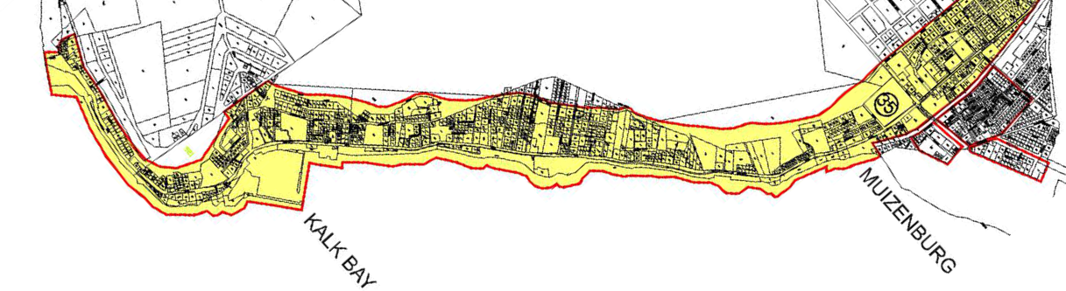
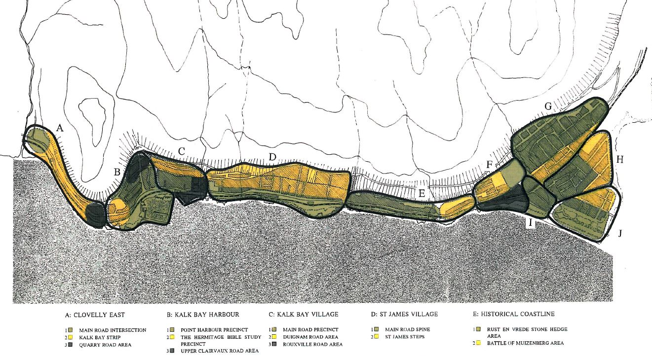
Extent of HPOZ

Slide 6
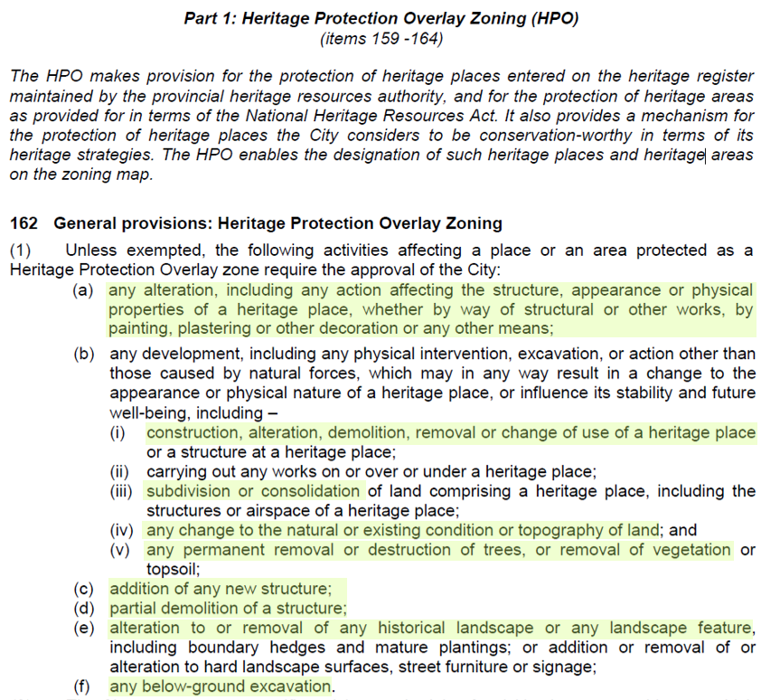
HPOZ triggers and exemptions

Slide 7
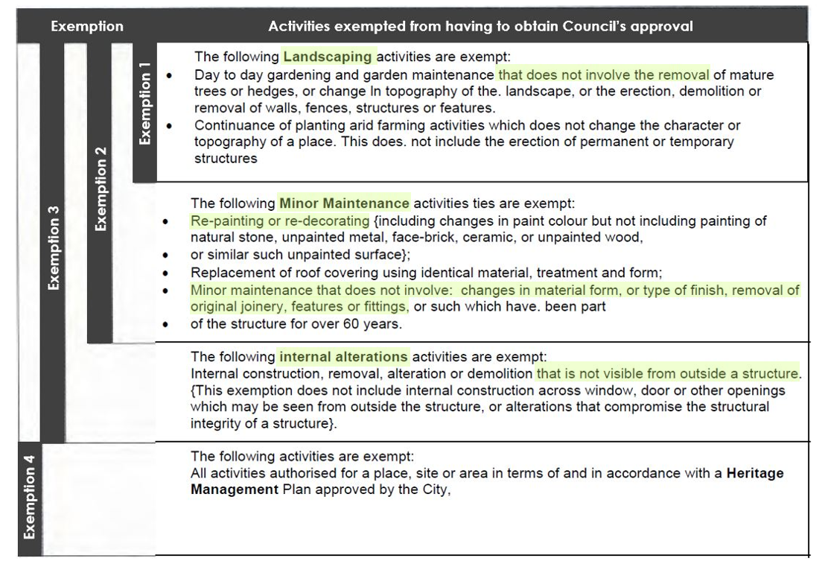
HPOZ triggers and exemptions
*These exemptions do not apply to HWC & BDM approvals

Slide 8
Available Resources
City’s Heritage Inventory
Heritage Advice Booklets and Pamphlets
Guidelines for work in Kalk Bay and St James Heritage Area
Advice from local conservation body
Advice from City E&HM Branch

Slide 9
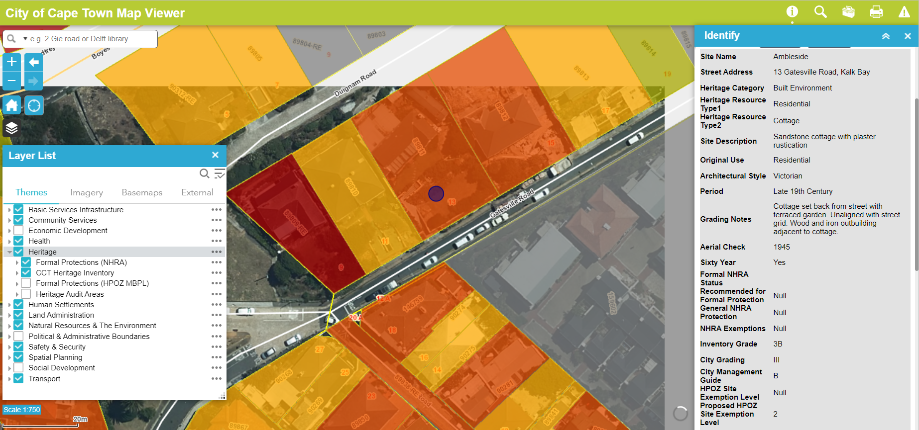
Available Resources
City’s Heritage Inventory https://citymaps.capetown.gov.za/EGISViewer/

Slide 10
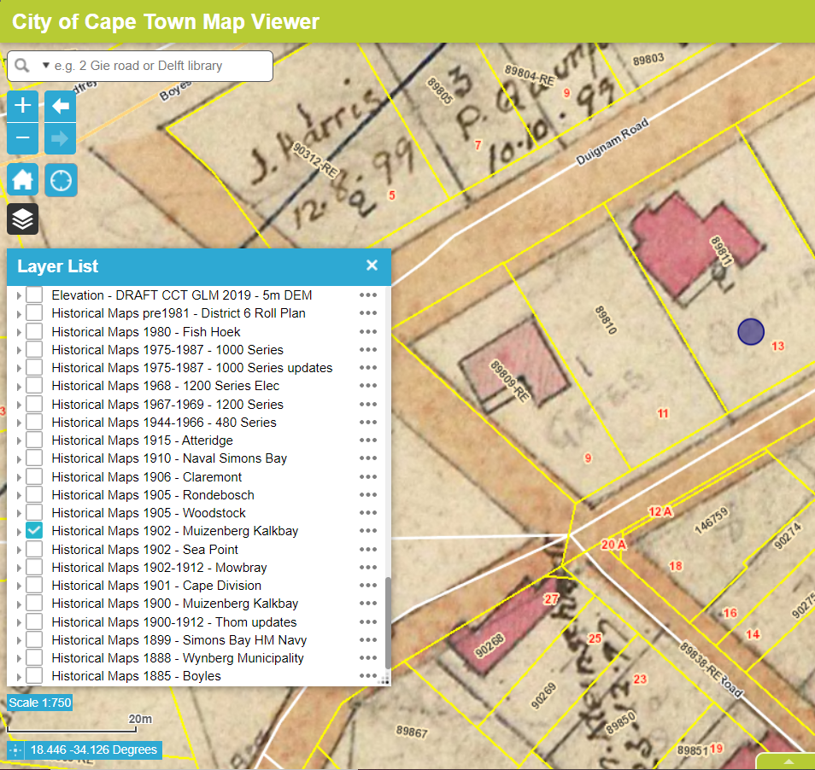
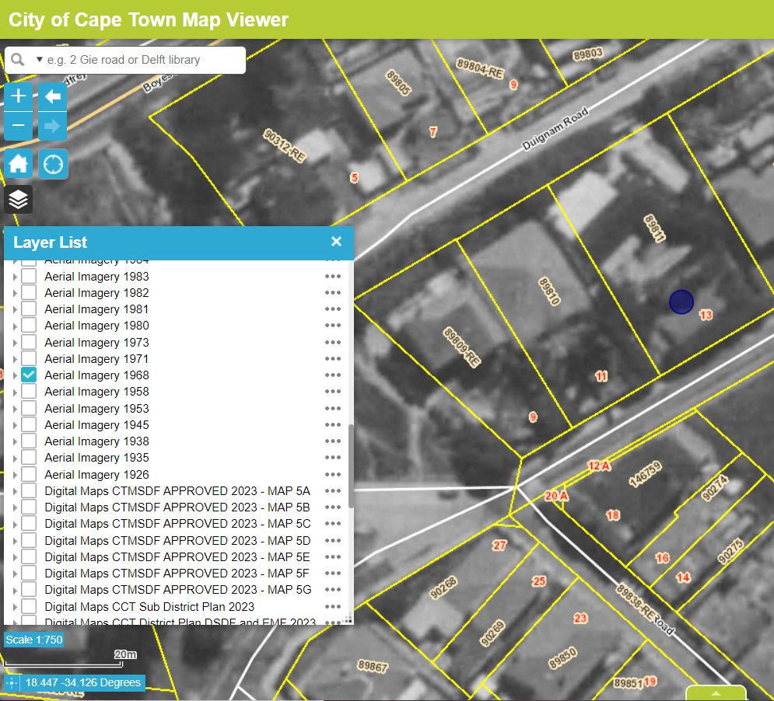
Available Resources
City’s Heritage Inventory – historical surveys and aerial photos

Slide 11
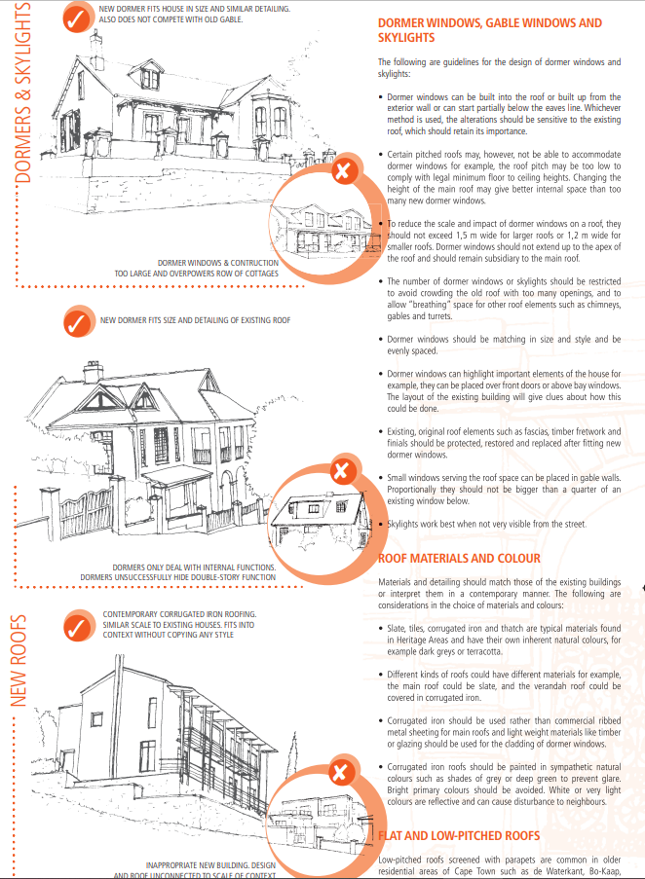
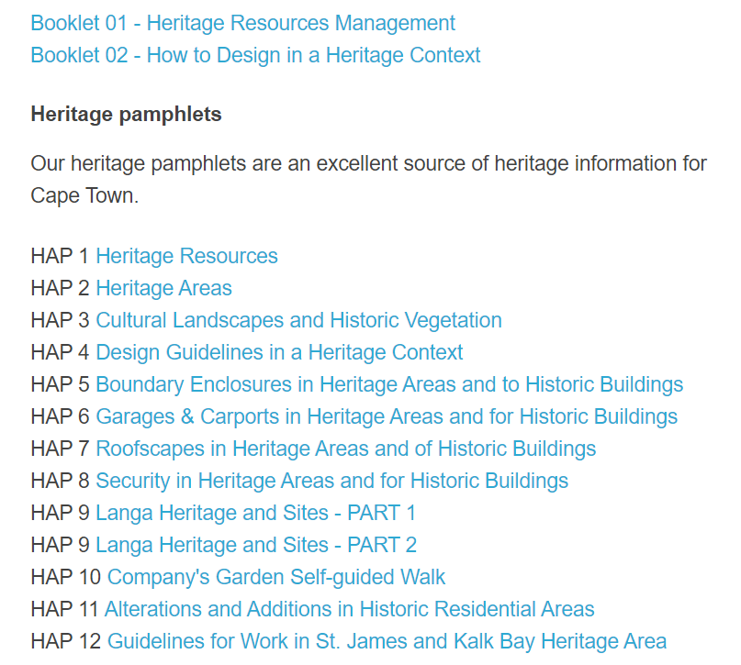
Available Resources
Heritage Advice Booklets and Pamphlets
https://www.capetown.gov.za/Family and home/education-and-research-materials/graphics-and-educational-material/environment-and-heritage-education-resources

Slide 12
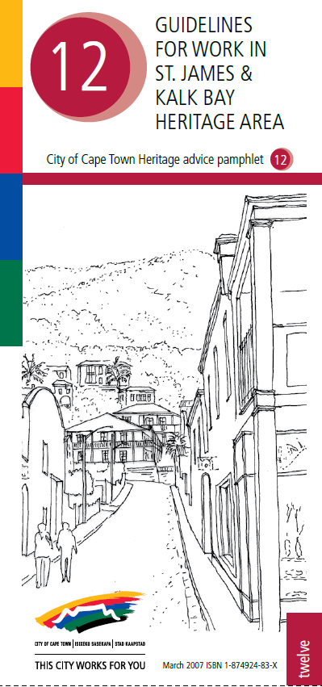
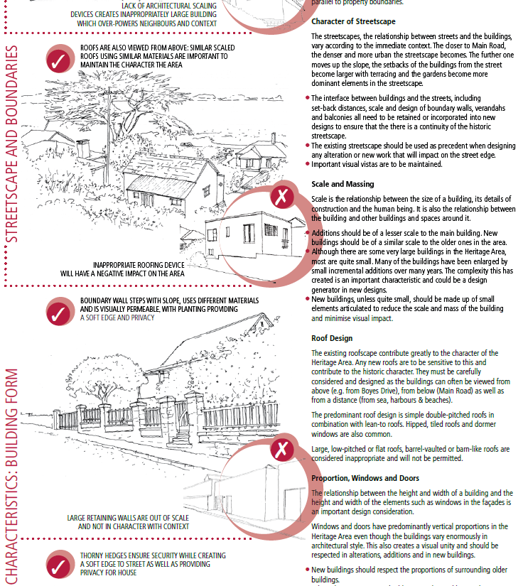
Available Resources
Guidelines for work in Kalk Bay and St James Heritage Area

Slide 13
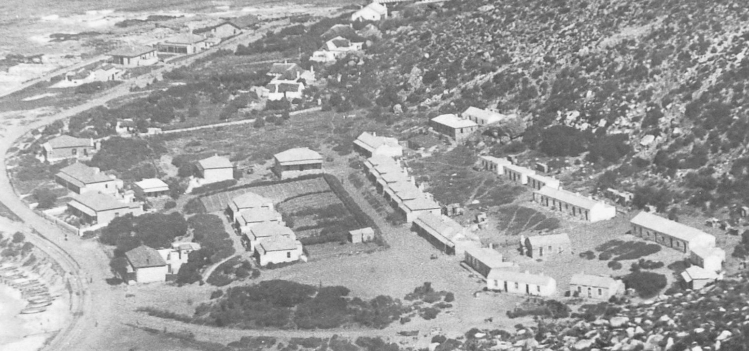
Available Resources
Advice from local conservation body
Advice from City E&HM Branch

Slide 14
Roles and Responsibilities
Shared responsibility to conserve the significance and character of the area and for new work to make a positive contribution to this historical character.
Owners
To be aware of applicable heritage protections
To not contravene these laws
Maintain their heritage resources
Architects
To be aware of applicable heritage protections
To take into account the heritage design guidelines that exist when designing alterations in the HPOZ
To consult with local conservation body and E&HM early in the design process
Compile adequate applications
City
To ensure negative impacts to heritage resources are prevented, minimised or mitigated
To be accessible and available for consultation
To be consistent and timeous
To ensure compliance

Slide 15
Heritage application process
Discuss proposals with E&HM – sketch plans / early consultation is welcomed and encouraged
We often meet on site with architect & conservation body to discuss proposals and resolve issues before a formal application is submitted to City
This makes the formal application process much simpler and smoother

Slide 16
For queries contact Philip Smith
Philip.Smith@capetown.gov.za / 021 444 1444

